Slide 1
AI Career Path Guide
CAPSTONE PROJECT
Presented By:
Student Name- Pulkit Dubey
College Name- Maulana Mazharul Haque Arabic & Persian University, Patna
Department- BCA

Slide 2
OUTLINE
Problem Statement
System Development Approach
Algorithm & Deployment (Step by Step Procedure)
Result
Conclusion
Future Scope(Optional)
References

Slide 3
Problem Statement
Increased career uncertainty, limited awareness of skill-based opportunities, and lack of personalized guidance have left many students confused about their future career choices. Traditional career counseling is often generic, inaccessible, or unable to address individual interests and aspirations.
Problem: There is a critical need for an accessible, personalized, and AI-driven guidance system that can provide tailored career recommendations, learning resources, and step-by-step roadmaps—especially for students unsure about their next academic or professional move.

Slide 4
System Approach
Frontend | Streamlit handles all user inputs, selections, and displays AI-generated guidance directly in the app.
Backend | Python code processes inputs, constructs prompts, and communicates with the AI model.
Model Engine | Gemini AI analyzes the user profile and generates tailored career paths, educational suggestions, and learning resources..
Data Handling | Streamlit secrets securely store the Gemini API key, and career information/resources are managed within the Python code or external JSON/database files if needed.

Slide 5
Algorithm & Deployment
1. Privacy & Security
User inputs (name, education, interests) are processed in-session and not stored without consent.
No personally identifiable information (PII) is exposed or logged.
Secure communication via HTTPS when deployed on Streamlit Cloud.
2. Availability
The app is accessible 24/7 through Streamlit Community Cloud.
Minimal downtime during updates or maintenance; auto-deploy ensures continuity.
3. Performance
AI responses generated in under 2–5 seconds depending on prompt complexity.
Efficient memory and compute usage via Streamlit to support low-resource devices.
4. Usability
Clean, intuitive interface built entirely with Streamlit components.
Easy navigation: text inputs, select boxes, radio buttons, expandable sections.
Mobile-friendly layout for accessibility on phones and tablets.
5. Scalability
Streamlit app supports multiple concurrent users without performance degradation.
Modular Python code allows easy integration of new features (e.g., additional career paths, multilingual support, or advanced AI models).

Slide 6
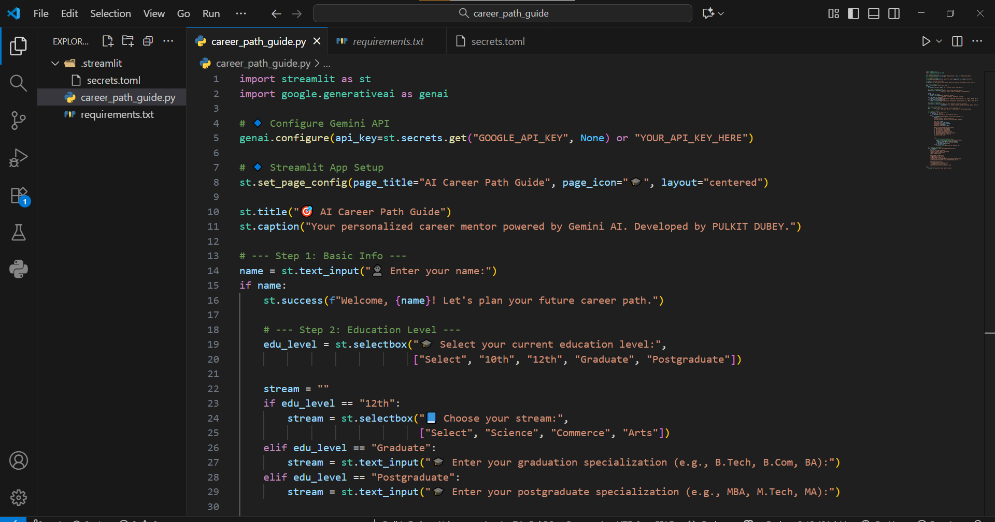
Result

Slide 7
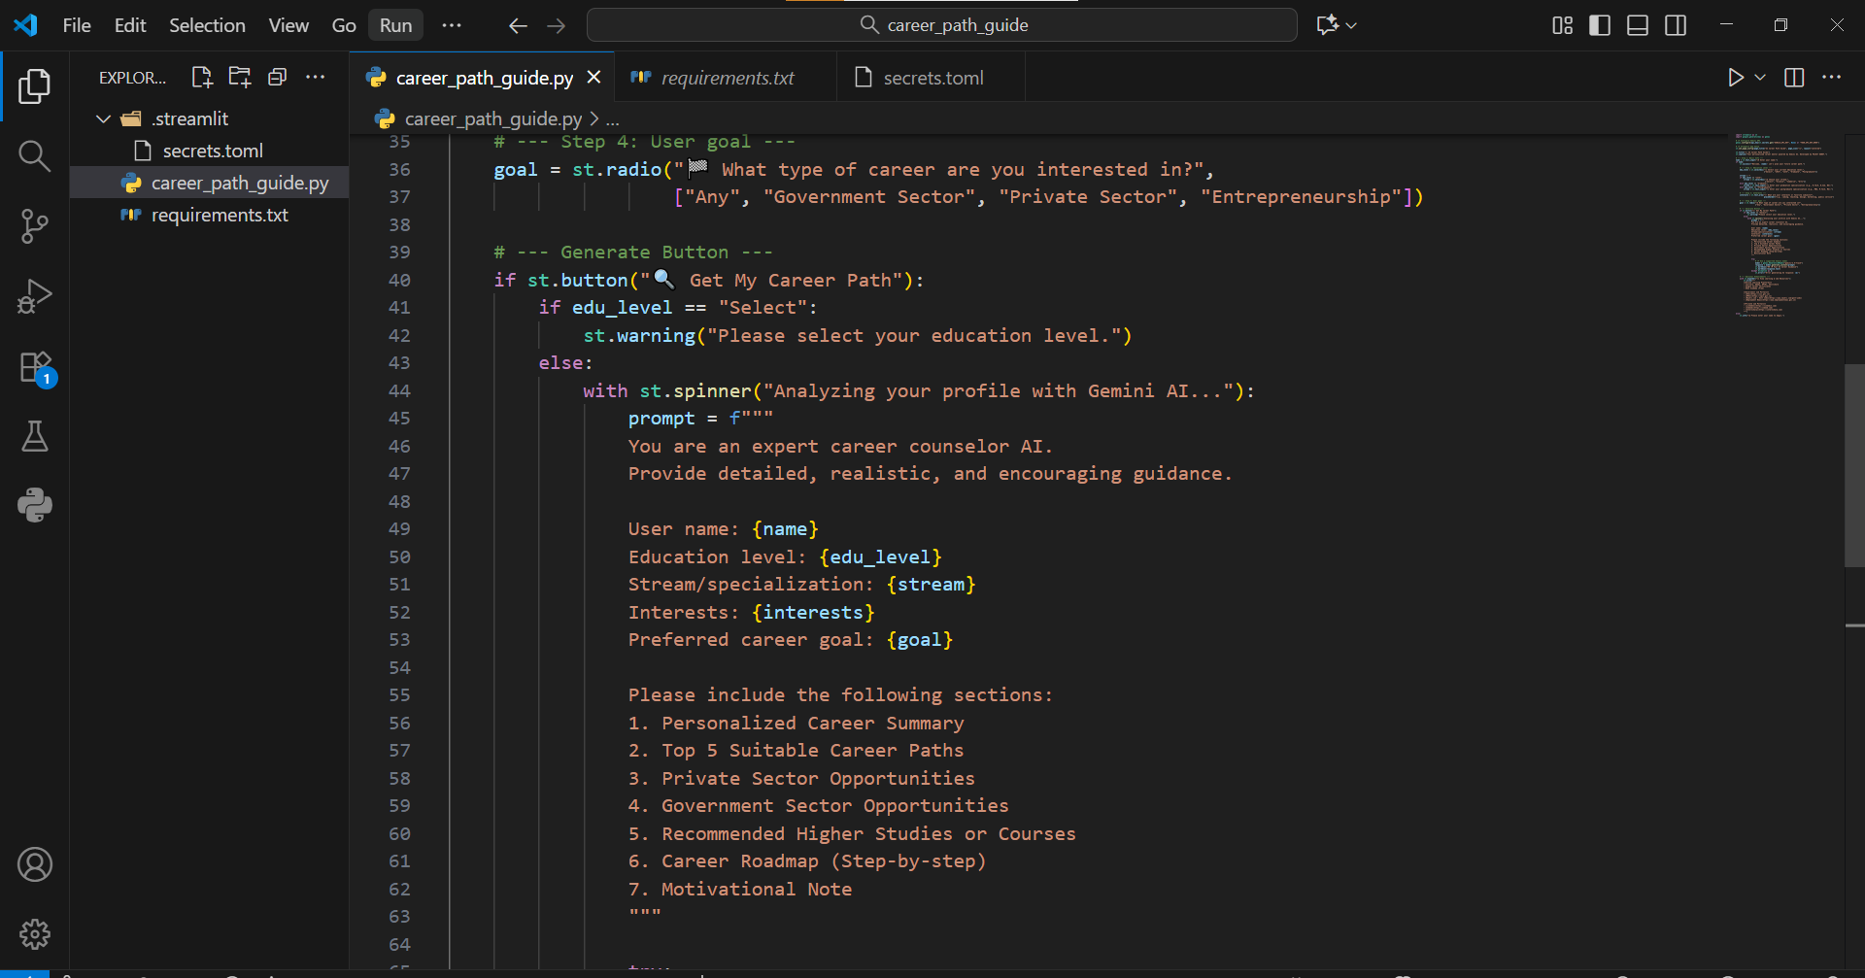
Result

Slide 8
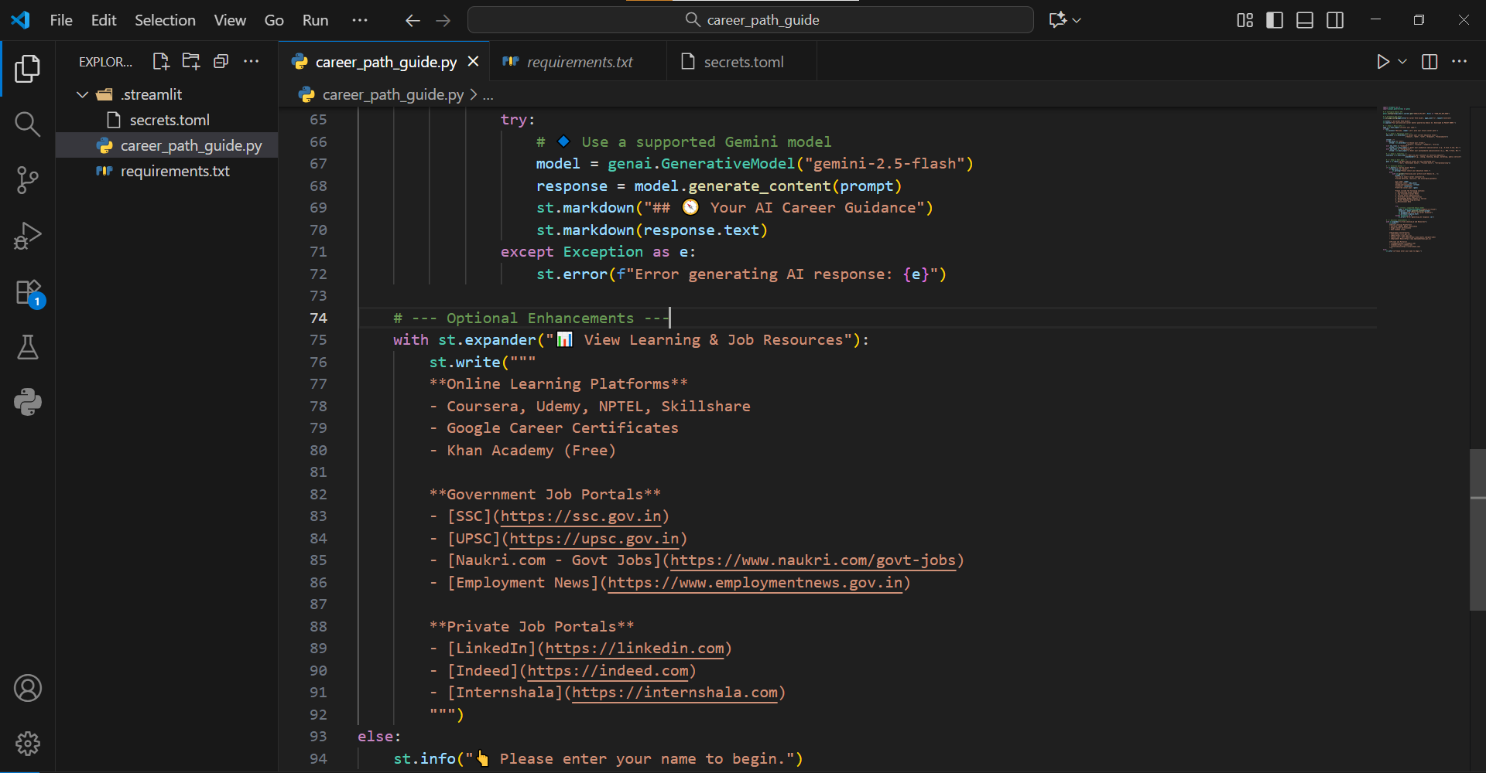
Result

Slide 9
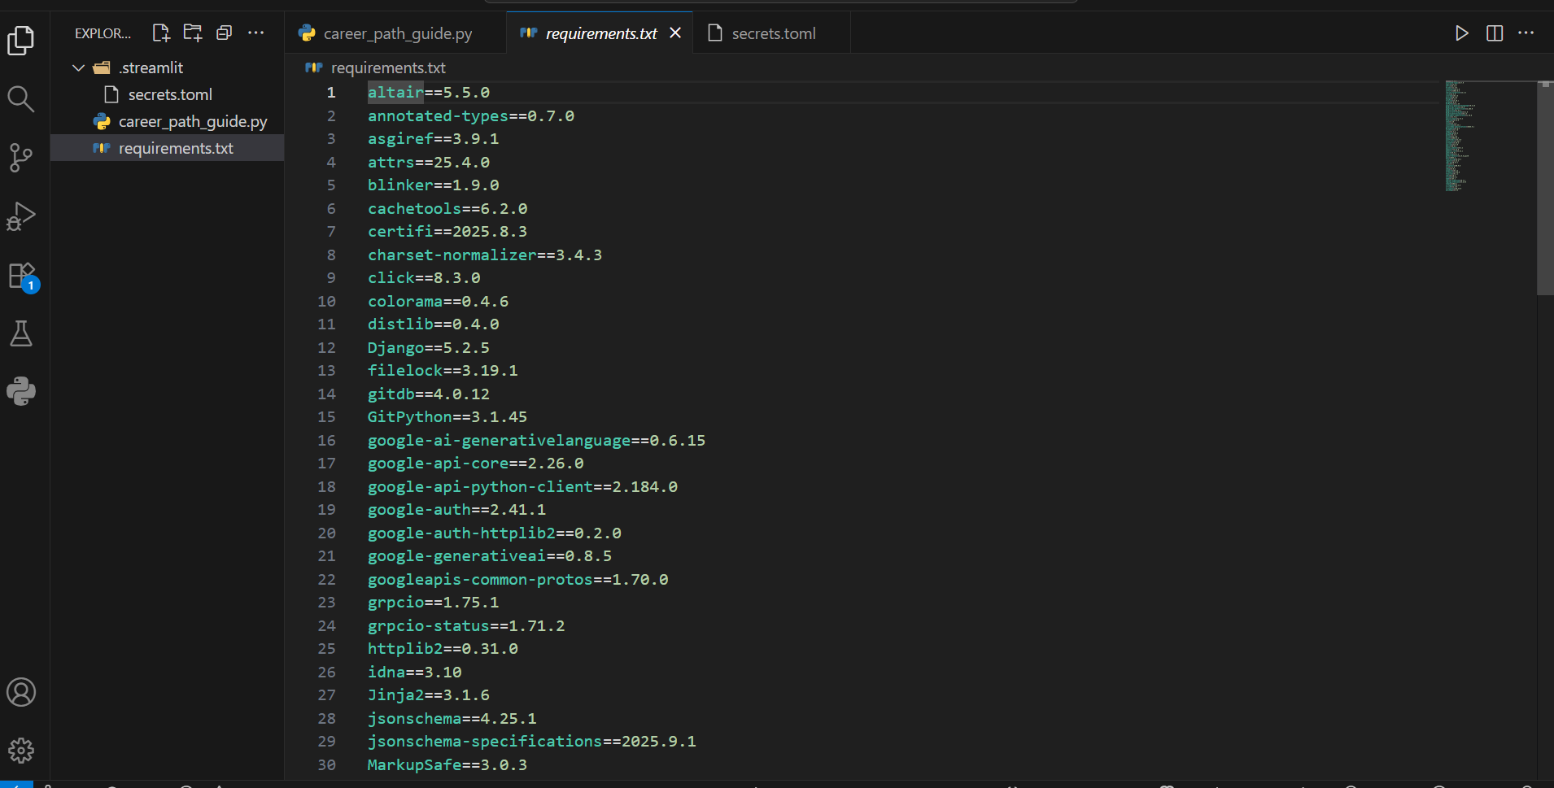
Result

Slide 10
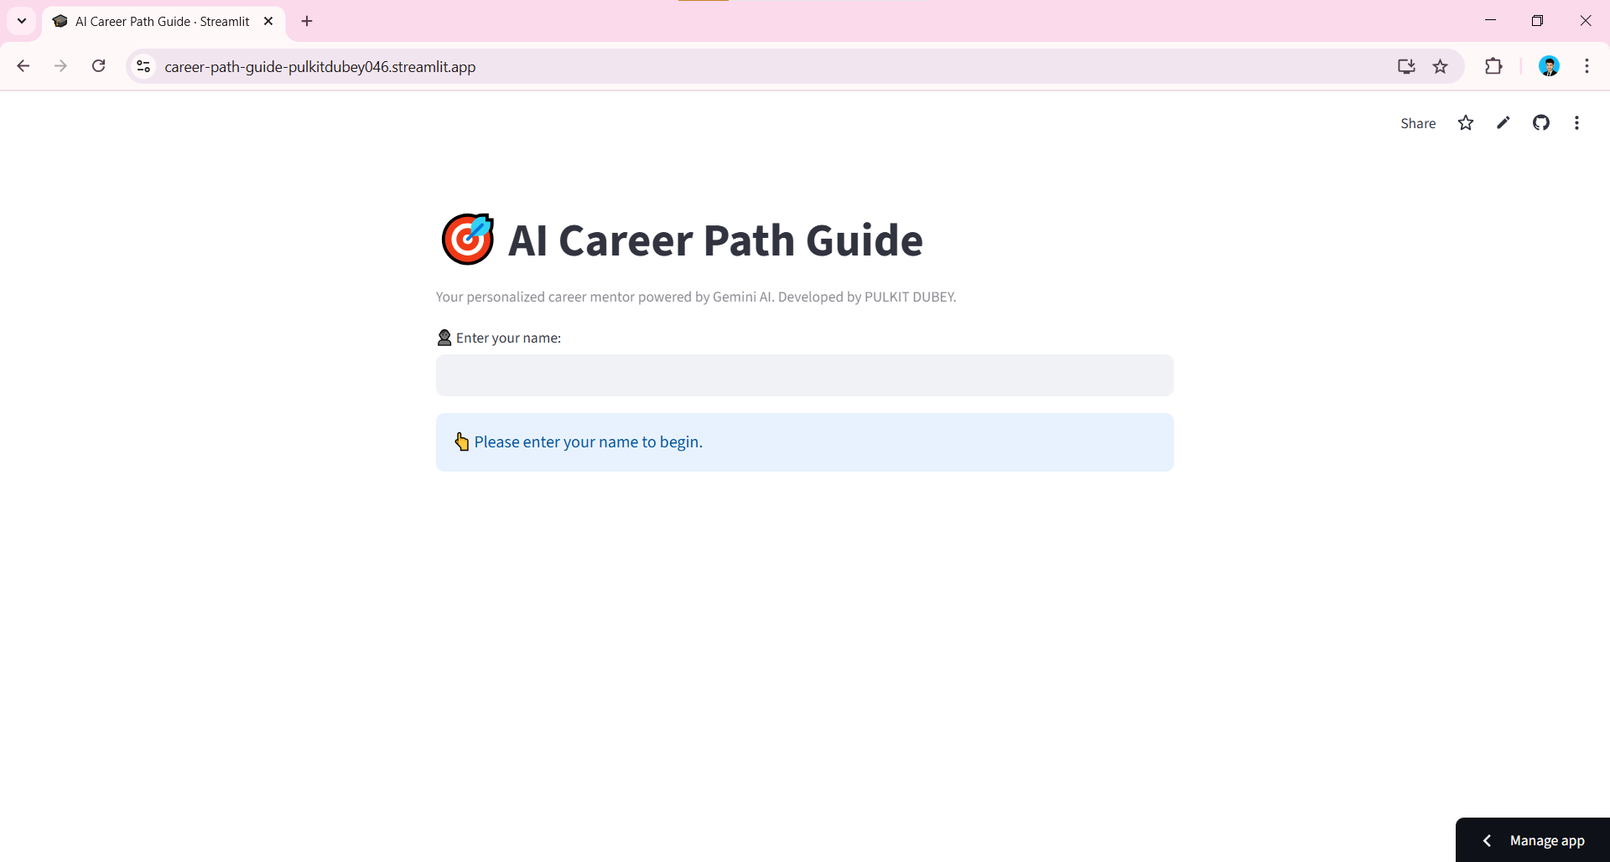
Result

Slide 11
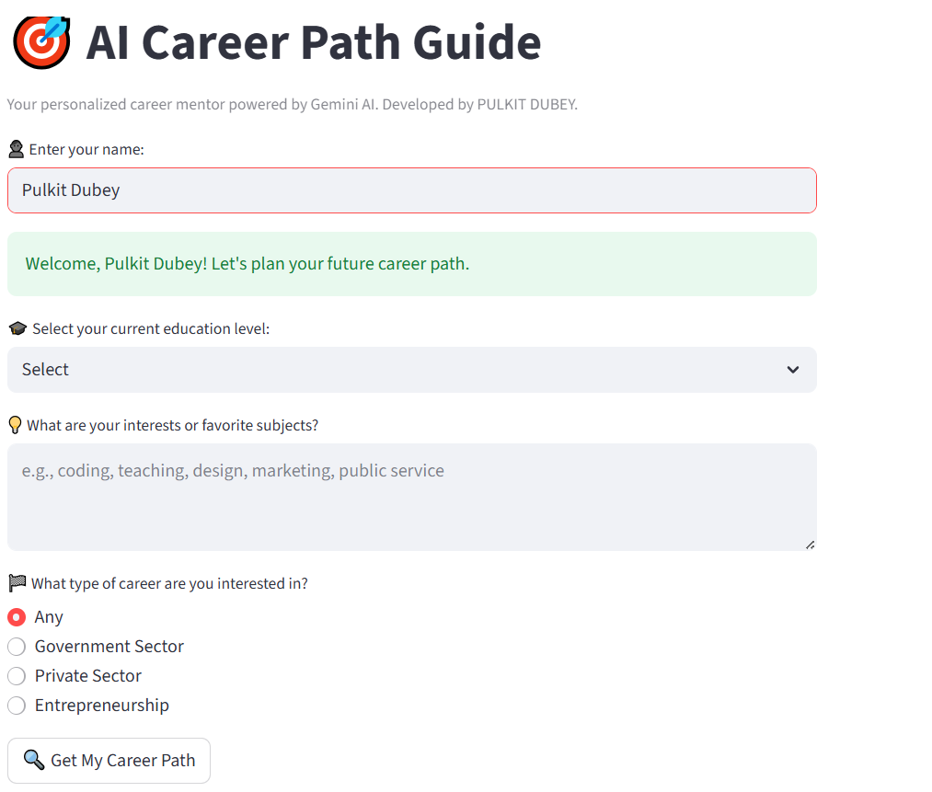
Result

Slide 12
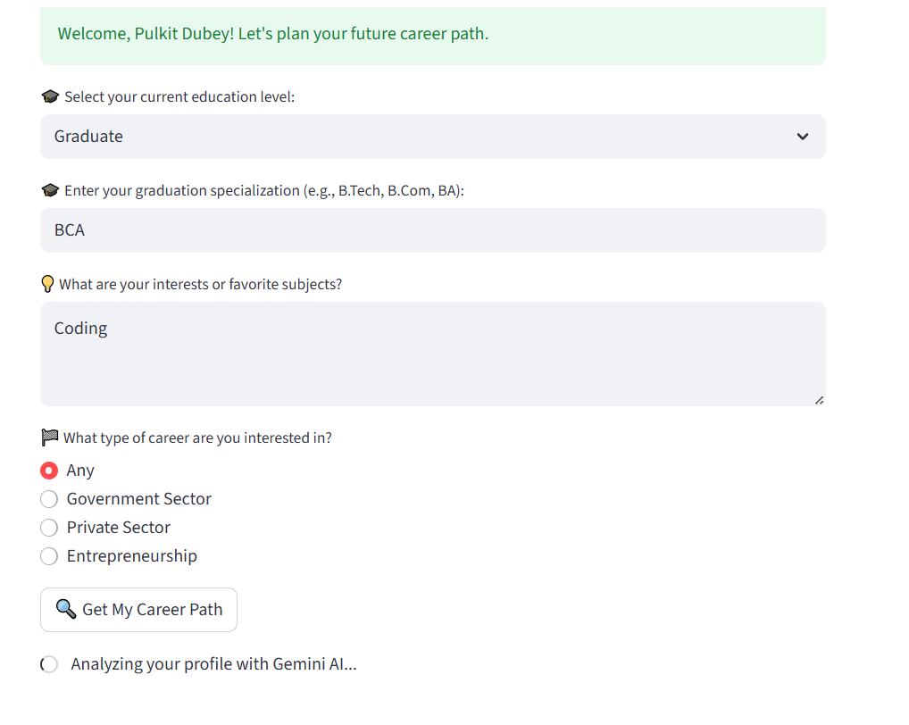
Result

Slide 13
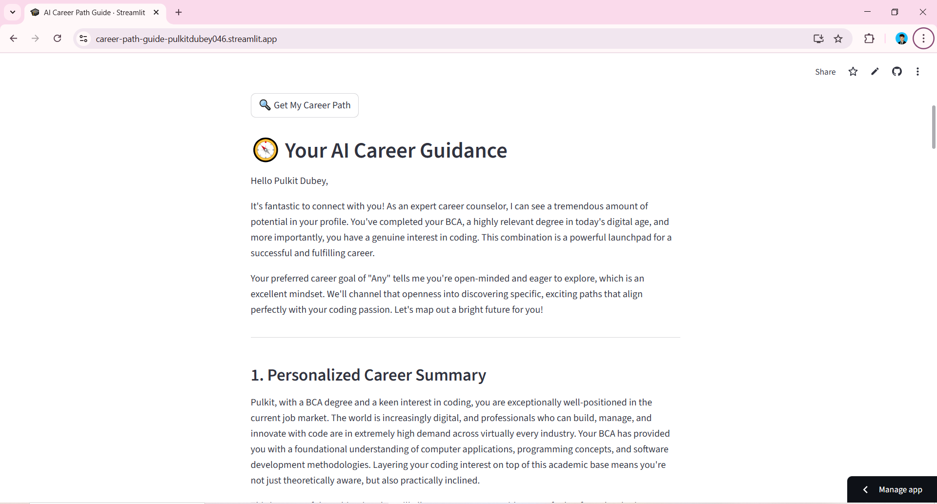
Result

Slide 14
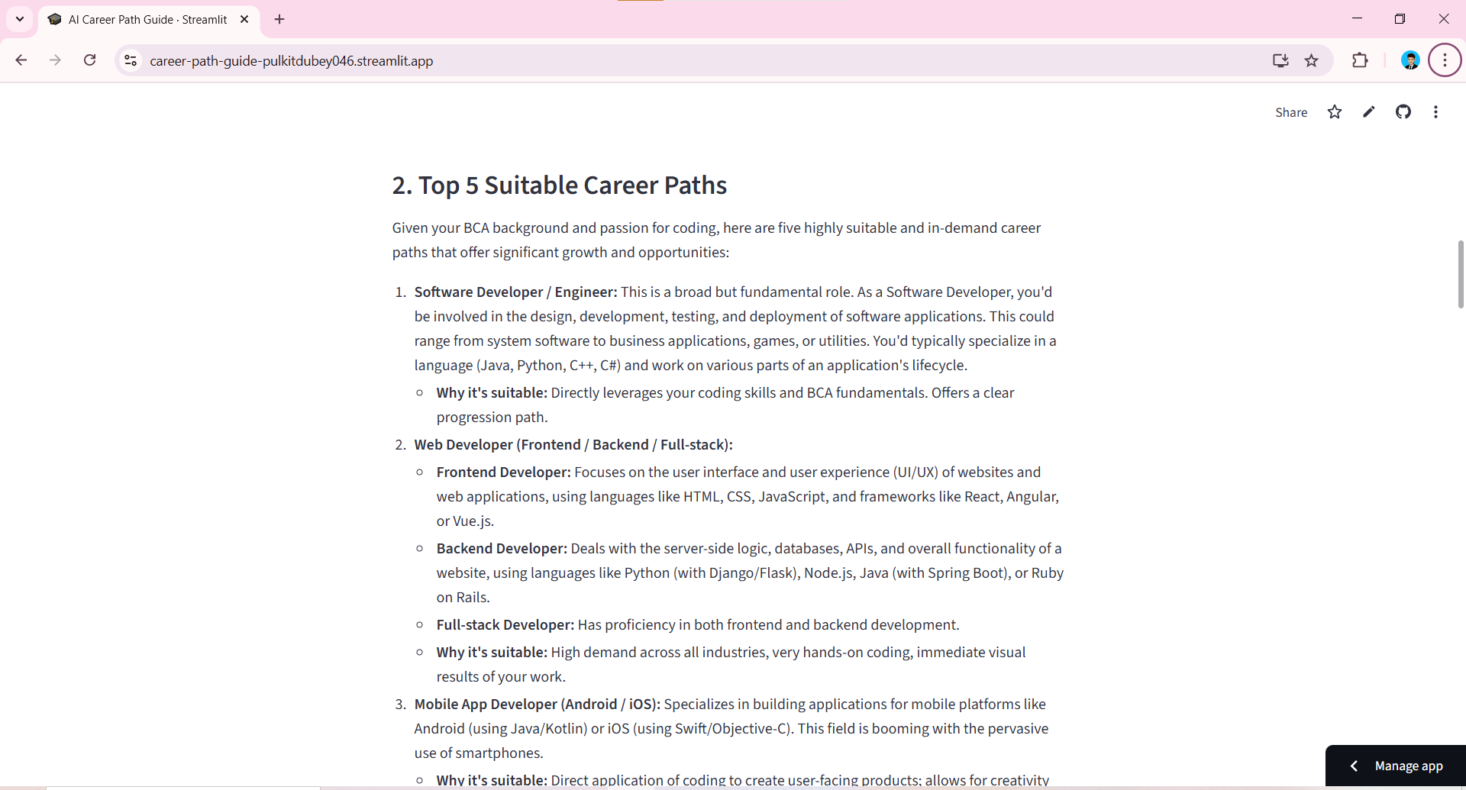
Result

Slide 15

Result

Slide 16
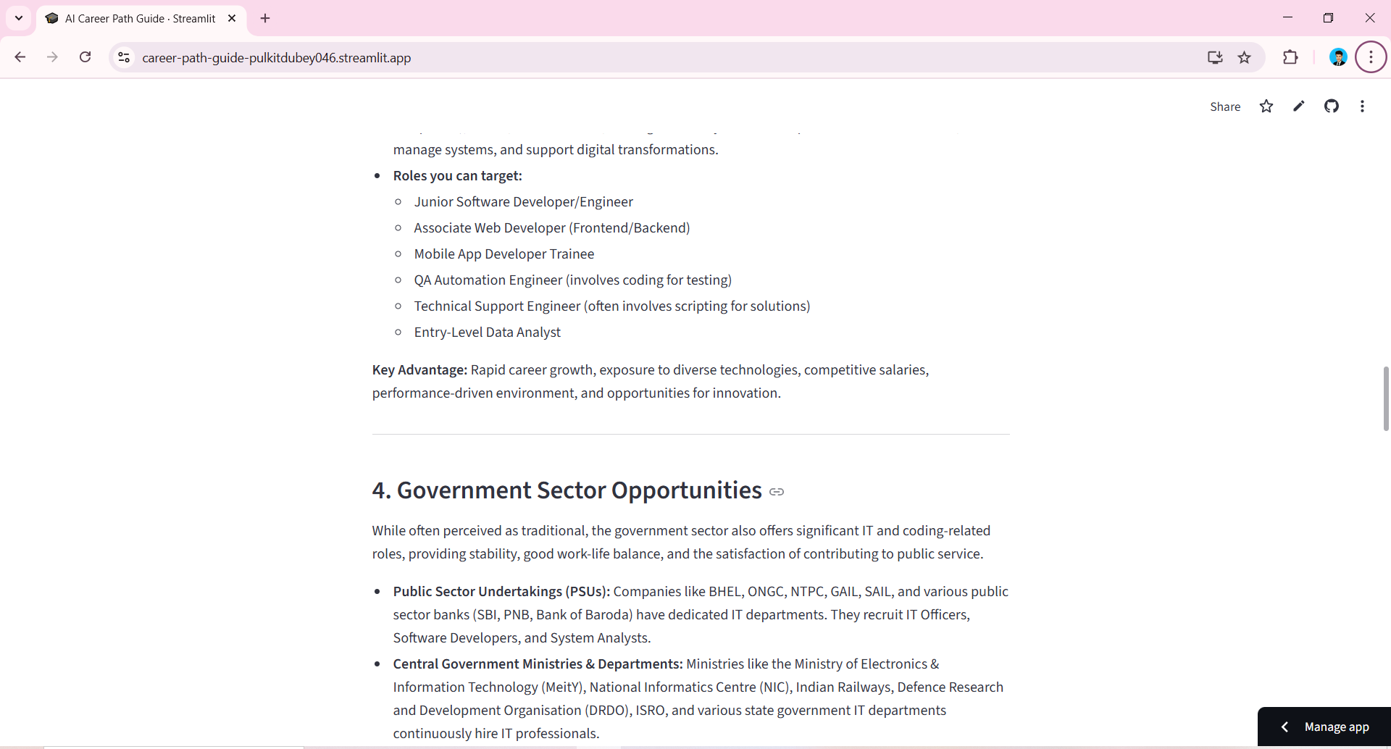
Result

Slide 17
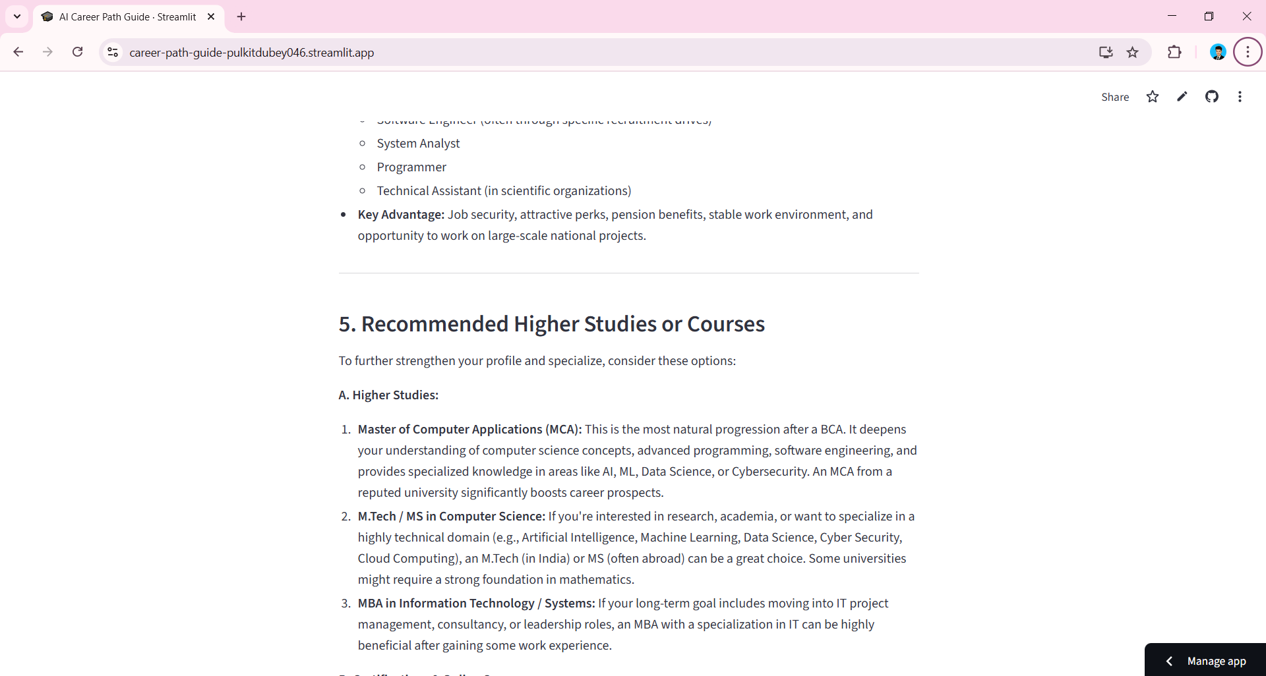
Result

Slide 18
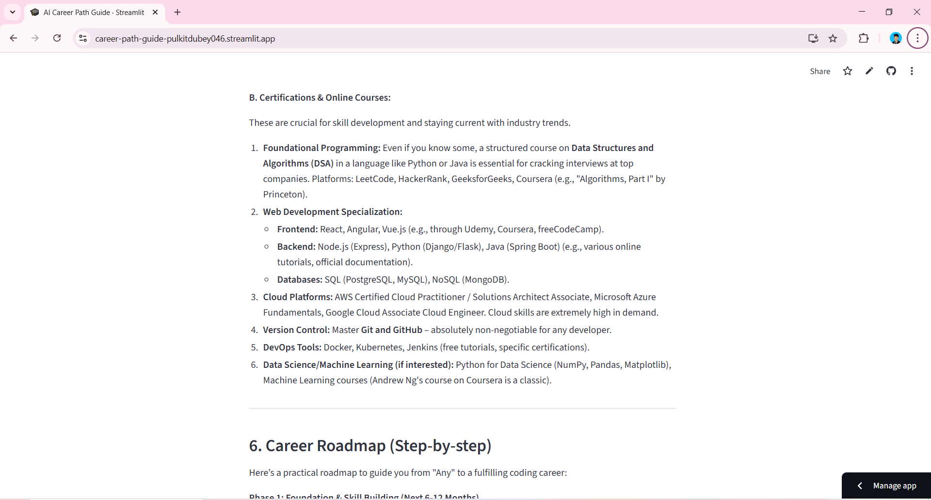
Result

Slide 19
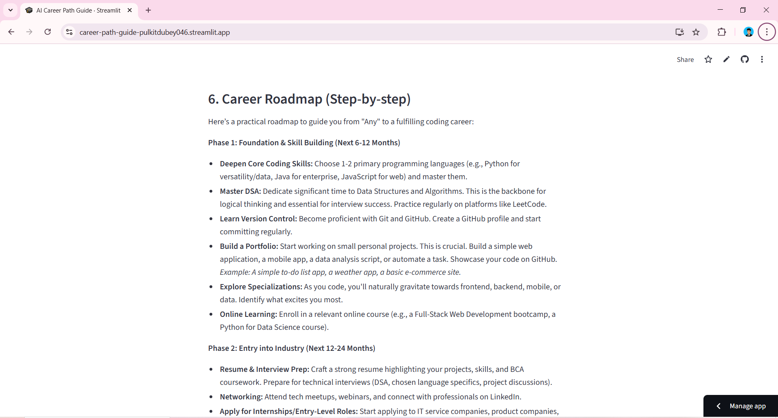
Result

Slide 20
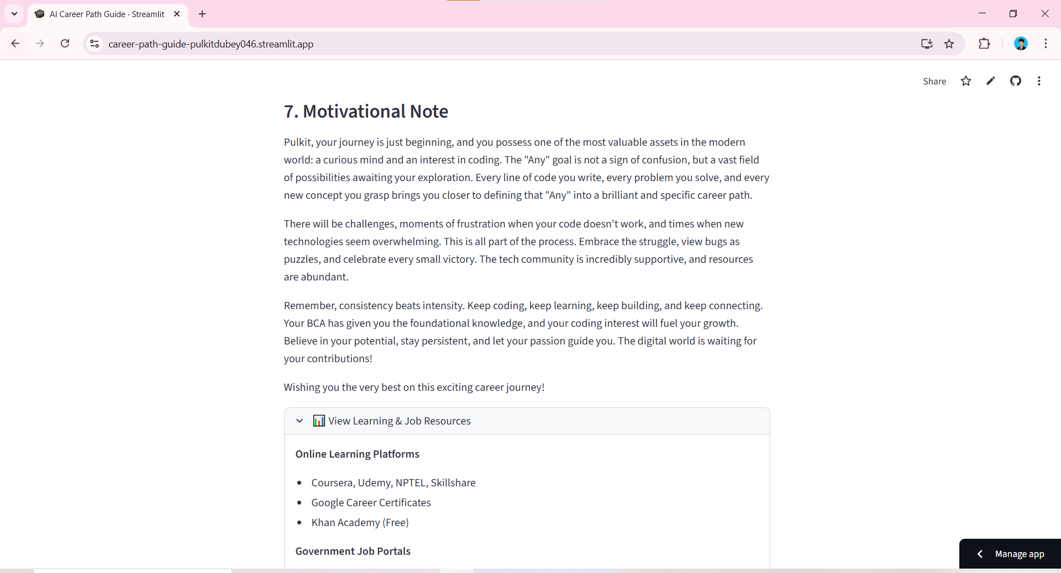
Result

Slide 21
GITHUB AND DEPLOYMNET LINK
Attach your Github Link : coding files GITHUB https://github.com/PulkitDubey046/career-path-guide
Deployment link: GITHUB/SOME OTHER PLATFORM
https://career-path-guide-pulkitdubey046.streamlit.app/

Slide 22
Conclusion
The development of the AI Career Path Guide using Gemini AI and Streamlit represents a significant step toward accessible, personalized, and tech-driven career guidance. By combining AI capabilities with a clean, interactive interface, the system offers students a safe and intuitive platform to explore career options, receive tailored recommendations, and plan their education and skill development—anytime, anywhere.

Slide 23
Future scope(Optional)
Add Voice Support: Allow users to speak their inputs and hear AI guidance for better accessibility.
Support More Languages: Include regional languages like Hindi, Tamil, and others to reach more students.
Work Offline: Enable offline functionality using lightweight AI models for areas with limited internet access.
Track Progress and Skills: Let users log completed courses, projects, and skills, and track growth over time.
Connect to Real Guidance: Provide links to career counselors, mentorship programs, and scholarship opportunities for personalized support.

Slide 24
References
Streamlit Documentation, https://docs.streamlit.io
Google Generative AI API Documentation, https://developers.generativeai.google
NIOS, SSC, UPSC Official Websites – Government Education & Career Portals
Online Learning Platforms: Coursera, Udemy, freeCodeCamp, Codecademy

Slide 25
THANK YOU

